Slide 1
CSC 325-002 Advanced Algorithms and Data Structures
Graphs and Graph Algorithms

Slide 2
Objective
To learn what a graph is and how it is used
To implement the graph ADT using multiple internal representations
How graphs can be applied to solve problems

Slide 3
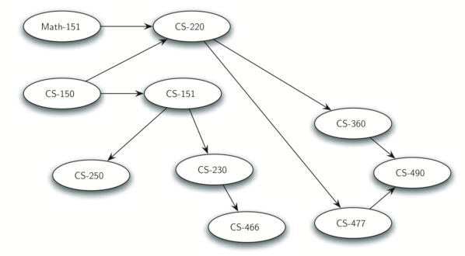
What are graphs?
Graphs are a more general structure than the trees
In fact trees is a special kind of graph.
Graphs can be used to represent many interesting things about our world
E.g., Sequence of classes you must take to complete a major in computer science.

Slide 4
Applications
Electronic circuits
Printed circuit board
Integrated circuit
Transportation networks
Highway network
Flight network
Computer networks
Local area network
Internet
Web
Databases
Entity-relationship diagram

Slide 5
Terminology
End vertices (or endpoints) of an edge
U and V are the endpoints of a
Edges/ arcs incident on a vertex
a, d, and b are incident on V
Edges may be one-way or two-way. If the edges in a graph are all one-way, we say that the graph is a directed graph, or a digraph.
Adjacent vertices
U and V are adjacent
Degree of a vertex
X has degree 5
Parallel edges
h and i are parallel edges
Self-loop
j is a self-loop
V
a
b
h
j
U
d
X
Z
c
e
i
W
g
f
Y

Slide 6
Vocabulary and Definitions
Vertex: A vertex (also called a “node”) is a fundamental part of a graph.
It can have a name, which we will call the “key.” A vertex may also have additional information.
Edge: An edge (also called an “arc”) is another fundamental part of a graph.
An edge connects two vertices to show that there is a relationship between them.
Edges may be one-way or two-way. If the edges in a graph are all one-way, we say that the graph is a directed graph, or a digraph.

Slide 7
Terminology (2)
Weight: Edges may be weighted to show that there is a cost to go from one vertex to another.
For example in a graph of roads that connect one city to another, the weight on the edge might represent the distance between the two cities.

Slide 8
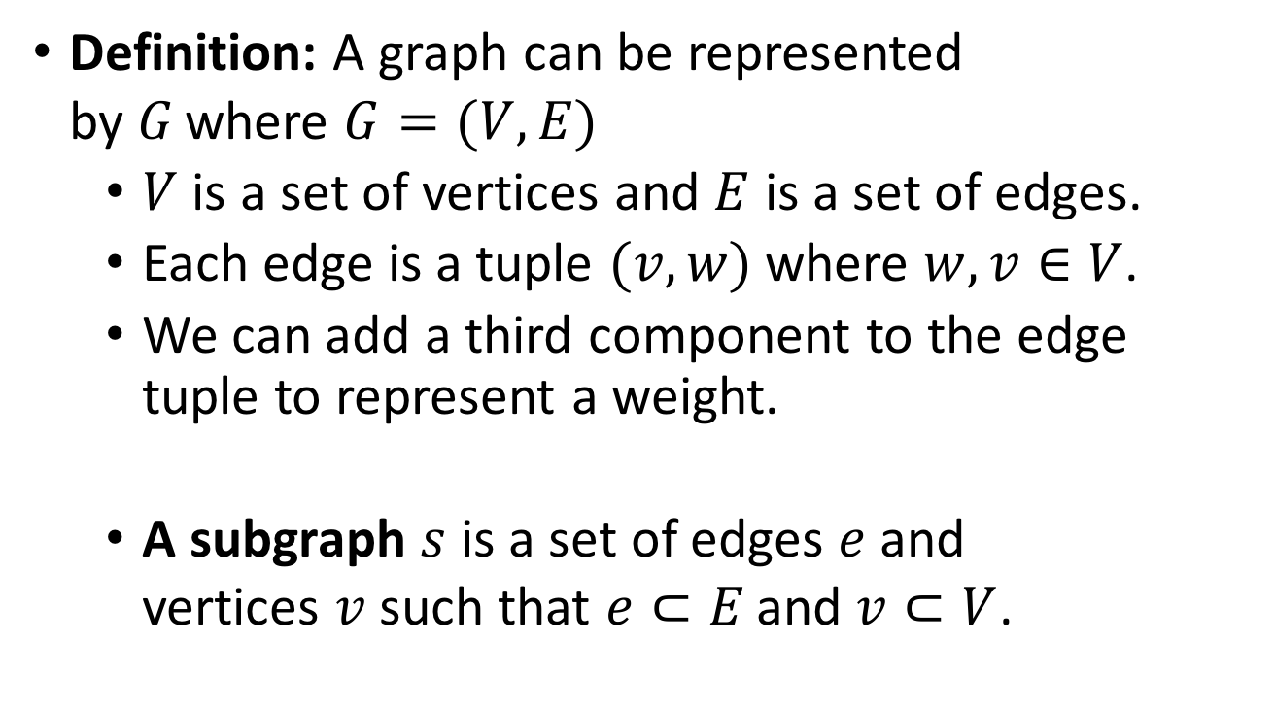
Terminology (3)
Definition: A graph can be represented by $G$where $G=(V,E)$
$V$ is a set of vertices and $E$ is a set of edges.
Each edge is a tuple $(v,w)$where $w,v∈V$.
We can add a third component to the edge tuple to represent a weight.
A subgraph $s$ is a set of edges $e$ and vertices $v$ such that $e⊂E$and $v⊂V$.

Slide 9
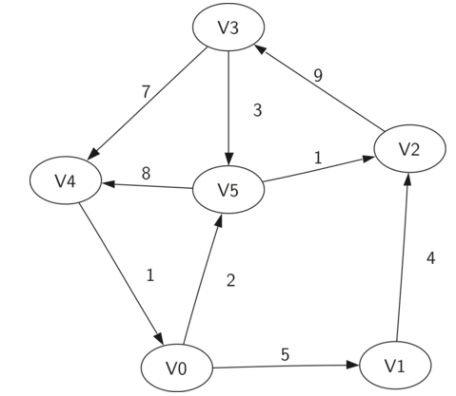

Terminology (4)

Slide 10
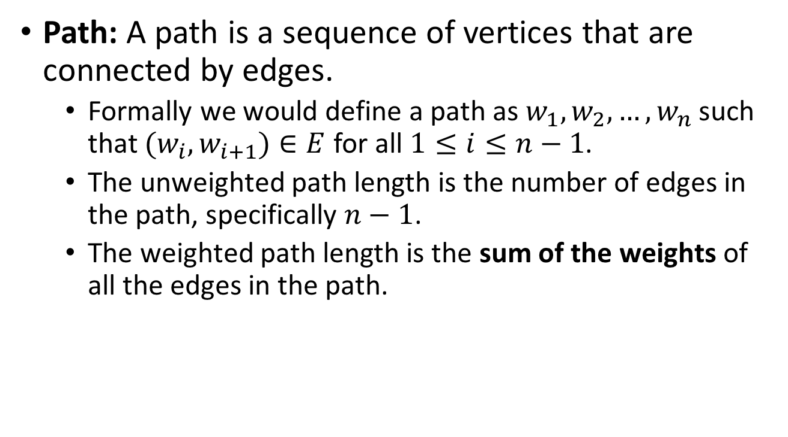
Terminology (5)
Path: A path is a sequence of vertices that are connected by edges.
Formally we would define a path as $w_{1},w_{2},…,w_{n}$ such that $(w_{i},w_{i+1})∈E$ for all $1≤i≤n−1$.
The unweighted path length is the number of edges in the path, specifically $n−1$.
The weighted path length is the sum of the weights of all the edges in the path.

Slide 11
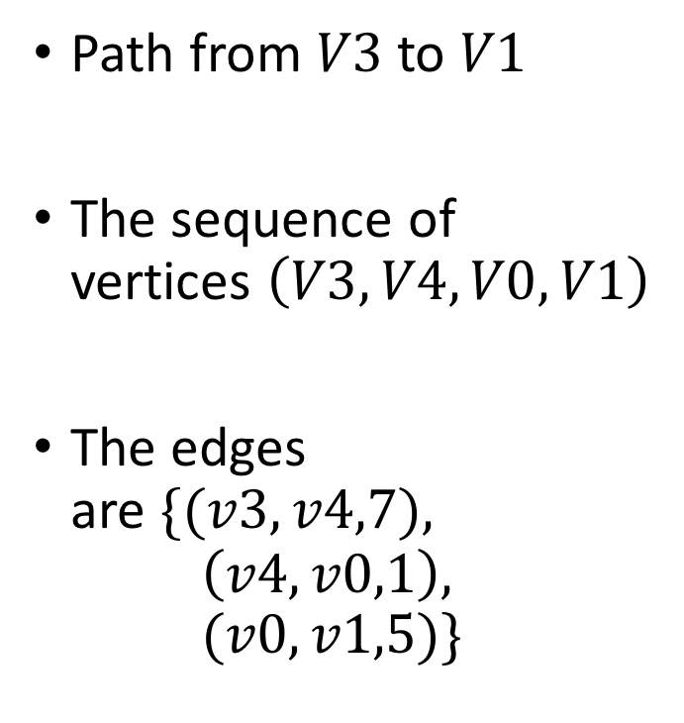
Terminology (6)
Path from $V3$ to $V1$
The sequence of vertices $\left(V3,V4,V0,V1\right)$
The edges are $\{(v3,v4,7),$ $\left(v4,v0,1\right),$ $(v0,v1,5)\}$

Slide 12
Terminology (cont.)
Simple path
path such that all its vertices and edges are distinct
Examples
P₁=(V,b,X,h,Z) is a simple path
P₂=(U,c,W,e,X,g,Y,f,W,d,V) is a path that is not simple
V
a
b
P₁
d
U
X
Z
P₂
h
c
e
W
g
f
Y

Slide 13
Vocabulary and Definitions (7)
Cycle: A cycle in a directed graph is a path that starts and ends at the same vertex.
E.g.: The path (V5,V2,V3,V5) is a cycle.
A graph with no cycles is called an acyclic graph.
A directed graph with no cycles is called a directed acyclic graph or a DAG.

Slide 14
Terminology (cont.)
Simple cycle
cycle such that all its vertices and edges are distinct
Examples
C₁=(V,b,X,g,Y,f,W,c,U,a,↵) is a simple cycle
C₂=(U,c,W,e,X,g,Y,f,W,d,V,a,↵) is a cycle that is not simple
V
a
b
d
U
X
Z
C₂
h
e
C₁
c
W
g
f
Y

Slide 15
The Graph ADT
Graph() creates a new, empty graph.
addVertex(vert) adds an instance of Vertex to the graph.
addEdge(fromVert, toVert) Adds a new, directed edge to the graph that connects two vertices.
addEdge(fromVert, toVert, weight) Adds a new, weighted, directed edge to the graph that connects two vertices.
getVertex(vertKey) finds the vertex in the graph named vertKey.
getVertices() returns the list of all vertices in the graph.
in returns True for a statement of the form vertex in graph, if the given vertex is in the graph, False otherwise.

Slide 16
Graph Implementations:
There are two well-known implementations of a graph:
The Adjacency Matrix and
The Adjacency List.

Slide 17
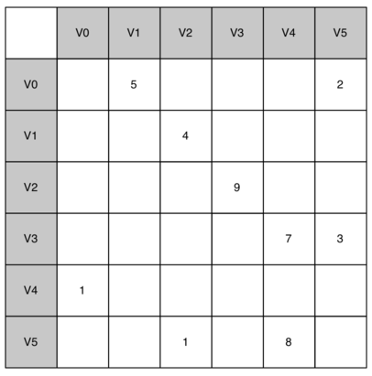
An Adjacency Matrix
Use a two-dimensional matrix.
The rows and columns of the matrix represent a vertex in the graph
The value that is stored in the cell at the intersection of row v & column w indicates if there is an edge from vertex v to vertex w.
vertices v and w are said to be adjacent to one another

Slide 18
An Adjacency Matrix (2)
The advantage of the adjacency matrix is that it is simple, and for small graphs it is easy to see which nodes are connected to other nodes.
A matrix is not a very efficient way to store sparse data.
The adjacency matrix is a good implementation for a graph when the number of edges is large.

Slide 19
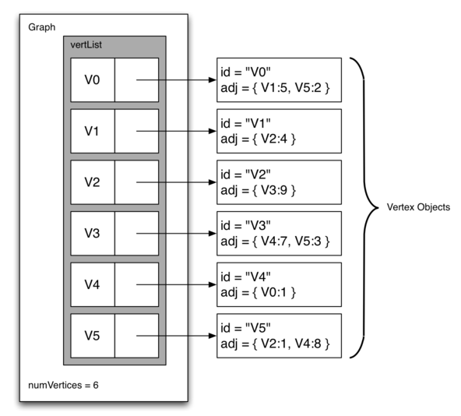
An Adjacency List
A more space-efficient way to implement a sparsely connected graph is to use an adjacency list.
In an adjacency list implementation we keep a master list of all the vertices in the Graph object
Each vertex object in the graph maintains a list of the other vertices that it is connected to.

Slide 20
An Adjacency List
Implementation of Vertex class we will use a dictionary rather than a list
dictionary keys - vertices, and
values -the weights.
Advantages:
It allows us to compactly represent a sparse graph.
Allows us to easily find all the links that are directly connected to a particular vertex.

Slide 21
Implementation
Implementation of the Graph ADT requires the creation of two classes:
Vertex: which will represent each vertex in the graph, and
Graph: which holds the master list of vertices.

Slide 22
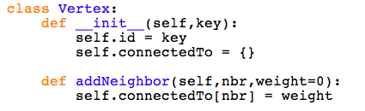
Implementation: Class Vertex

Slide 23
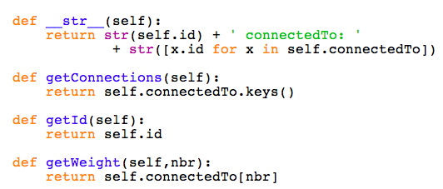
Implementation: Class Vertex

Slide 24
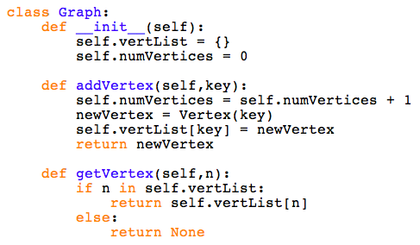
Implementation: Class Graph

Slide 25
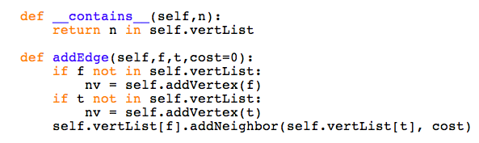

Implementation: Class Graph

Slide 26
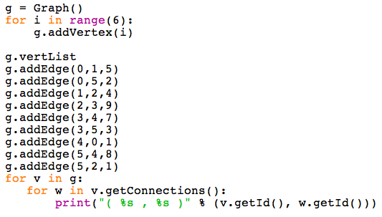
Implementation: Create a Graph

Slide 27
The Word Ladder Problem

Slide 28

The Word Ladder Problem
Transform the word “FOOL” into the word “SAGE”.
In a word ladder puzzle you must change one letter at a time.
At each step you must transform one word into another word, you are not allowed to transform a word into a non-word.
GOAL: Figure out the smallest number of transformations needed to turn the starting word into the ending word.

Slide 29
The Word Ladder Problem
GOAL: Figure out the smallest number of transformations needed to turn the starting word into the ending word.
Objective:
Represent the relationships between the words as a graph.
Use the graph algorithm known as breadth first search to find an efficient path from the starting word to the ending word.

Slide 30
Step 1: Building the Word Ladder Graph
How to turn a large collection of words into a graph?
Let’s start with the assumption that we have a list of words that are all the same length.
What would an edge from one word to another capture?
Place an edge if the two words are only different by a single letter.
Potential Solution: Any path from one word to another is a solution to the word ladder puzzle

Slide 31
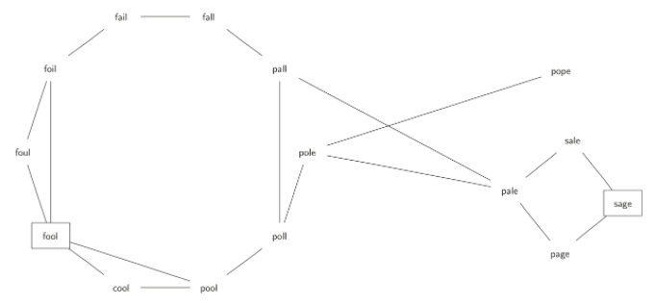
Step 1: Building the Word Ladder Graph
How to turn a large collection of words into a graph?
What would an edge from one word to another capture?
Place an edge if the two words are only different by a single letter.
Any path from one word to another is a solution to the word ladder puzzle
Notice that the graph is an undirected graph and that the edges are unweighted

Slide 32
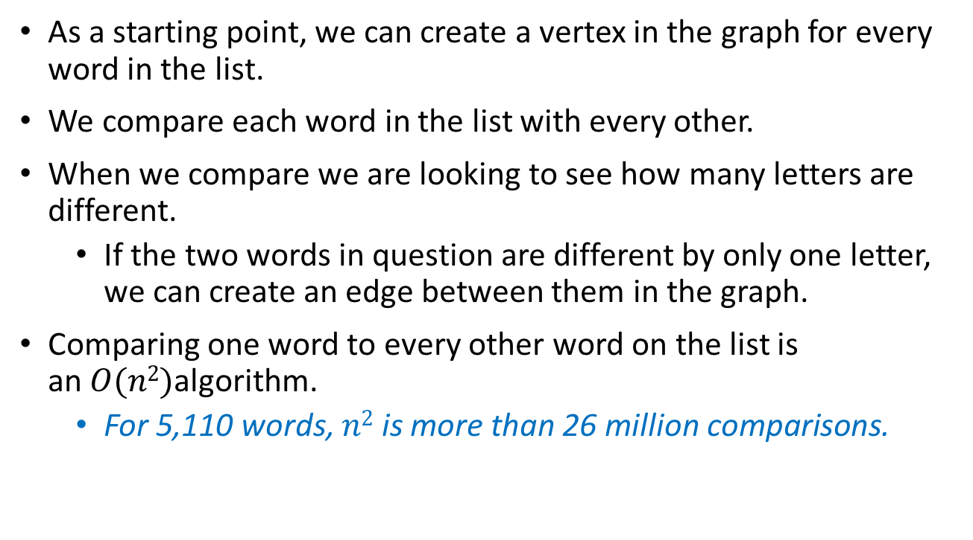
Step 1: Building the Word Ladder Graph
As a starting point, we can create a vertex in the graph for every word in the list.
We compare each word in the list with every other.
When we compare we are looking to see how many letters are different.
If the two words in question are different by only one letter, we can create an edge between them in the graph.
Comparing one word to every other word on the list is an $O(n2)$algorithm.
For 5,110 words, $n2$ is more than 26 million comparisons.

Slide 33
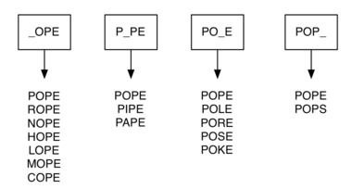
Step 1: Building the Word Ladder Graph
Alternate Solution:
Suppose that we have a number of buckets, each of them representing a four-letter word, except that one of the letters in the label has been replaced by an underscore.
We place in a bucket all the words that match the letters except for the underline letter
Once we have all the words in the appropriate buckets we know that all the words in the bucket must be connected.

Slide 34
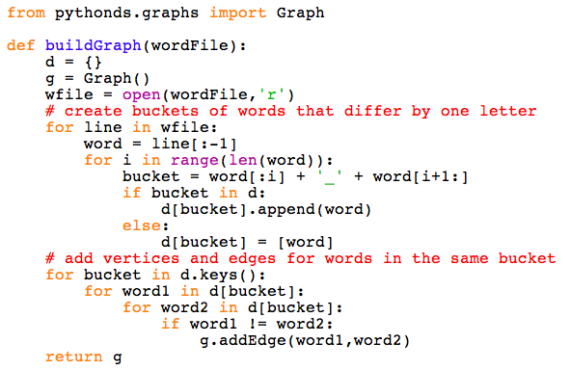
Step 1: Implementation

Slide 35
Step 2: Implementing Breadth First Search
Find the shortest solution to the word ladder problem
Breadth first search (BFS) is one of the easiest algorithms for searching a graph.
Given a graph G and a starting vertex s
The breadth first search proceeds by exploring edges in the graph to find all the vertices in G for which there is a path from s.
Notes:
Breadth first search finds all the vertices that are a distance k from s before it finds any vertices that are a distance k+1.

Slide 36
BFS - working
One good way to visualize what the breadth first search algorithm does is to imagine that it is building a tree, one level of the tree at a time.
A breadth first search adds all children of the starting vertex before it begins to discover any of the grandchildren.
BFS colors each of the vertices white, gray, or black.
All the vertices are initialized to white when they are constructed. A white vertex is an undiscovered vertex.
When a vertex is initially discovered it is colored gray, and
When BFS has completely explored a vertex it is colored black.

Slide 37
Step 2: Implementing Breadth First Search
The breadth first search algorithm uses the adjacency list graph representation
It uses a Queue, to decide which vertex to explore next.
We will use the vertex class from the pythonds package:
Adds three new instance variables to vertex: distance, predecessor, and color.

Slide 38
Step 2: Implementing Breadth First Search
BFS begins at the starting vertex s and colors start gray to show that it is currently being explored.
Two other values, the distance and the predecessor, are initialized to 0 and None respectively for the starting vertex.
Finally, start is placed on a Queue.
The next step is to begin to systematically explore vertices at the front of the queue.
We explore each new node at the front of the queue by iterating over its adjacency list.
As each node on the adjacency list is examined its color is checked.

Slide 39
Step 2: Implementing Breadth First Search
If it is white, the vertex is unexplored, and four things happen:
The new, unexplored vertex nbr, is colored gray.
The predecessor of nbr is set to the current node currentVert
The distance to nbr is set to the distance to currentVert + 1
nbr is added to the end of a queue.
Notes:
Adding nbr to the end of the queue effectively schedules this node for further exploration, but not until all the other vertices on the adjacency list of currentVert have been explored.

Slide 40
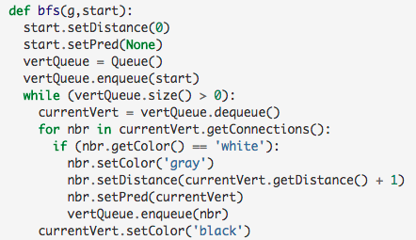
Step 2: Implementing Breadth First Search

Slide 41
Constructing the breadth first tree
Starting from fool we take all nodes that are adjacent to fool and add them to the tree.
The adjacent nodes include pool, foil, foul, and cool.
Each of these nodes are added to the queue of new nodes to expand.

Slide 42
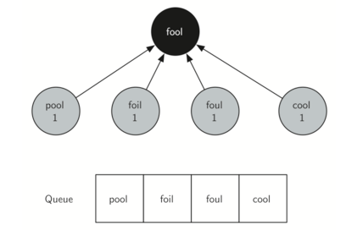
Constructing the breadth first tree

Slide 43
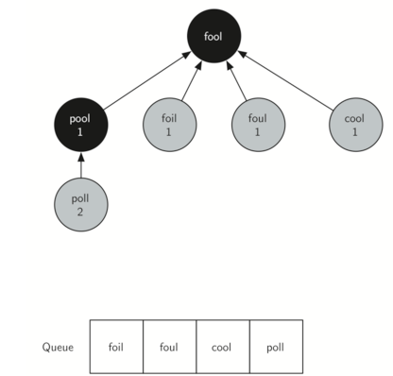
Constructing the breadth first tree

Slide 44
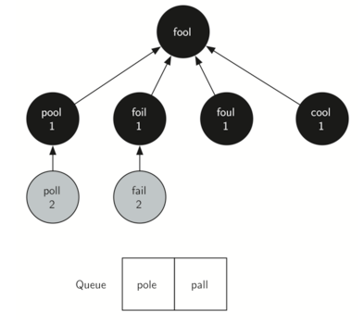
Constructing the breadth first tree

Slide 45
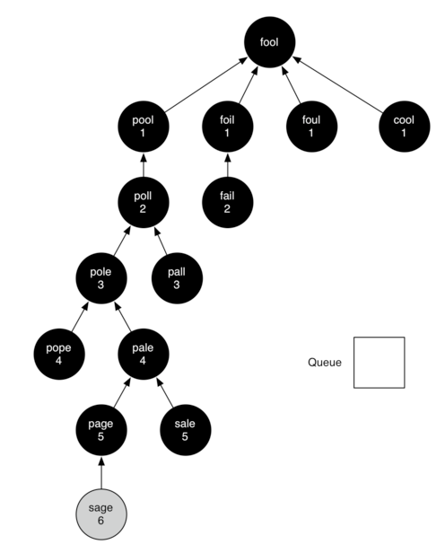
Constructing the breadth first tree

Slide 55
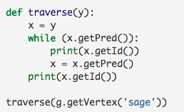
Print out the word ladder

Slide 56
Constructing the breadth first tree

